Slide 1
UCI Data set
Predicting contraceptive usage
CLASSIFICATION PROBLEM – DOUG & dEEPAK

Slide 2
Dataset selection
Pulled from UCI classification area
Includes demographic information
Identify Instance, Target, and Possible Features
Target: What type (if any) of contraceptive is used
~1500 instances

Slide 3
Data description
Wife's age (numerical)
Wife's education (categorical) 1=low, 2, 3, 4=high
Husband's education (categorical) 1=low, 2, 3, 4=high
Number of children ever born (numerical)
Wife's religion (binary) 0=Non-Islam, 1=Islam
Wife's now working? (binary) 0=Yes, 1=No
Husband's occupation (categorical) 1, 2, 3, 4
Standard-of-living index (categorical) 1=low, 2, 3, 4=high
Media exposure (binary) 0=Good, 1=Not good
Contraceptive method used (class attribute) 1=No-use 2=Long-term 3=Short-term

Slide 4
Data ingestion
Stand-alone CSV
Import directly from CSV via Python
Convert to to DataFrame in Pandas
Describe and explore data to determine if any data is missing or bad

Slide 5
Data wrangling
Fill in missing values with average
Convert alphanumeric/categorical fields to numerical
Build dummy variables & binning data

Slide 6
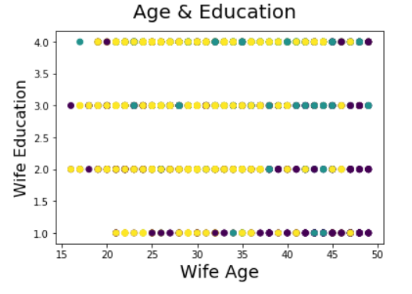
Preliminary look at data

Slide 7
Analyze feature relationships
Check for correlation between attributes
Identify collinear data
Remove collinear features, so there is only one left from each highly correlated pair
Do a correlation matrix

Slide 8
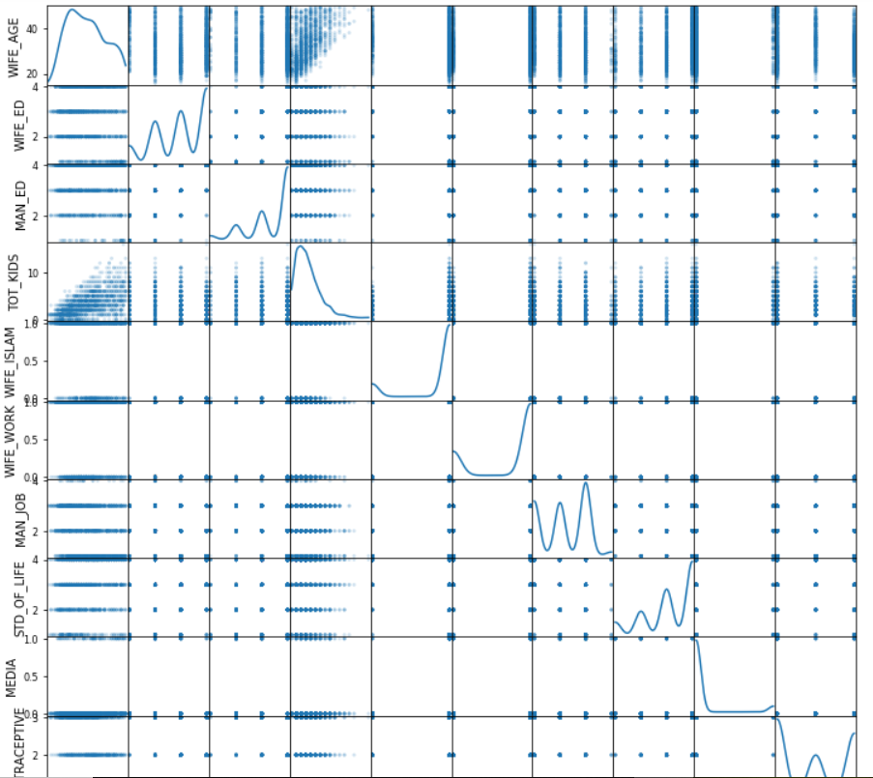
Relationships

Slide 9
Prepare data for model
Scale data so it can run through the model
Split – Train – Test
Determine what train/test ratio you would like
Check the classification results
Precision
Recall
F-1 Score

Slide 10
RUN TRAINING DATA THROUGH MODELS
Try the training data in multiple classification models
Use the automatic scikitlearn parameters
Determine which models look the most promising
Deep dive on the best models

Slide 11
Hyper parameter tuning
Use yellowbrick to test the hyperparameters for the selected models
Identify the best hyperparameter values
Review model results

Slide 12
Classification report
Run true test data through model
Compare predicted results to actual results
Score the model

Slide 13
Visualization
Identify the most significant variables
Visualize the most significant variables
Report on the findings of the model

